Slide 1
Lockdown
Maintaining (initiating) Orthodox Christian life during isolation

Slide 2
Let us pray to the Lord
Our Father, in heaven, hallowed be Your name.
Your kingdom come, Your will be done on earth, as it is in heaven.
Give us today our daily bread, and forgive us our sins as we forgive those who sin against us and lead us not into temptation but deliver us from evil.

Slide 3
Lockdown!
Isolation
Uncertainty
Fear
Time
Opportunity

Slide 4
Avoid
Do not become angry
Do not become despondent
Do not inadvertently add to your children’s (family’s) fear and panic

Slide 5
Protest against impacts of the lockdown!
There is no doubting the negative impacts of the lockdown. However, by adopting a Christian struggle during lockdown, we can turn it into a positive experience.
Reconnect
Pray
Read

Slide 6
Be careful, the children are watching…
Children learn through observation.
Christian practices and behaviours need to be modelled in the home.
One cannot accidentally come to correct moral behaviour. They must be guided (Kohlberg).
“When your children are still small, you have to help them understand what is good. That is the deepest meaning of life.” – Saint Paisios

Slide 7
What is prayer?
Prayer is the mutual and personal encounter with God; the elevation of the mind and the heart to God in praise, in thanksgiving, and in petition for the spiritual and material goods we need. Our Lord Jesus Christ commanded us to enter into our inner room and there pray to God the Father in secret. This inner room means the heart, the core of our being.
It is through prayer that we open ourselves to the invisible, imperceptible power of God.
To pray is to stand in awe before God with our whole being – soul, mind and heart.

Slide 8
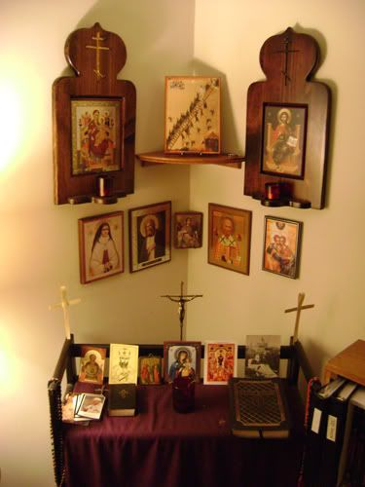
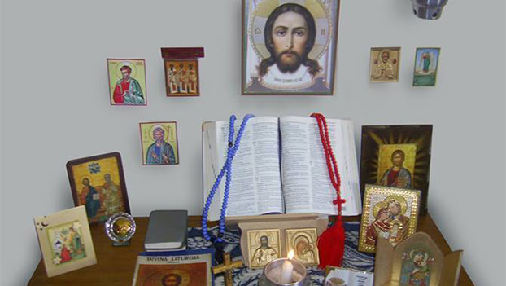
Dedicate a regular place for prayer

Slide 9
Sample Prayer Rule
Begin by lighting a candle, and making prostrations and stand quietly to collect yourself in your heart
Trisagion Prayer
One of six Morning or Evening Psalms
Intercessions for the living and the dead
Psalm 50 and confession of our sinfulness
Doxology and the morning or evening prayer
Personal dialogue with God
Jesus prayer – Prayer Rope.
Reflect on the tasks of the day and prepare for the difficulties you might face asking God to help you .
Dismissal prayer
Repeat the Jesus Prayer in your mind whenever you can throughout the day.

Slide 10
Will God hear my prayer?
“Ask and it will be given to you; seek and you will find; knock and the door will be open to you. For everyone who asks receives; he who seeks finds; and to him that knocks, the door will be opened.” (Matt 7:7-8)
Prayer will illuminate the mind and soul and the answer to our request becomes apparent. We may never hear the voice of God, but what we are promised is that the Holy Spirit will work within us as our hearts and motives are purified through prayer.

Slide 11
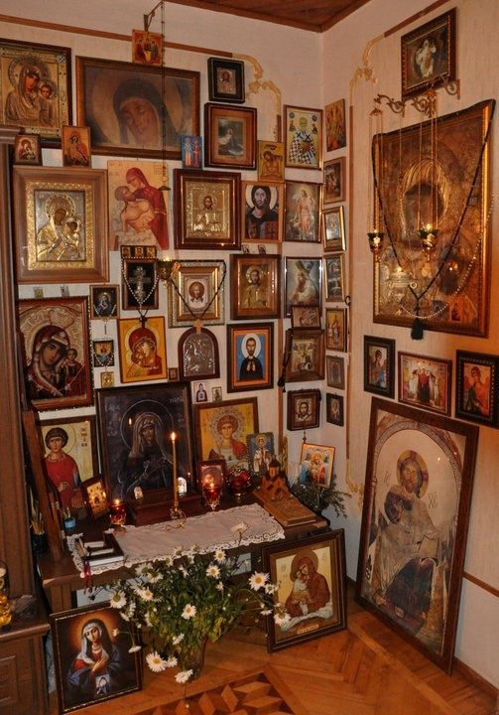
Will God hear my prayer?
“Be anxious for nothing, but in everything by prayer and supplication, with thanksgiving, let your requests be made known to God; and the peace of God, which surpasses all understanding, will guard your hearts and minds through Christ Jesus.” (Philip 4:6-7)
Struggle with patience and perseverance!

Slide 12
Looking After our Wellbeing
Uncertainty, Stress & Worry
Keeping Productive (balanced)
General Wellbeing

Slide 13
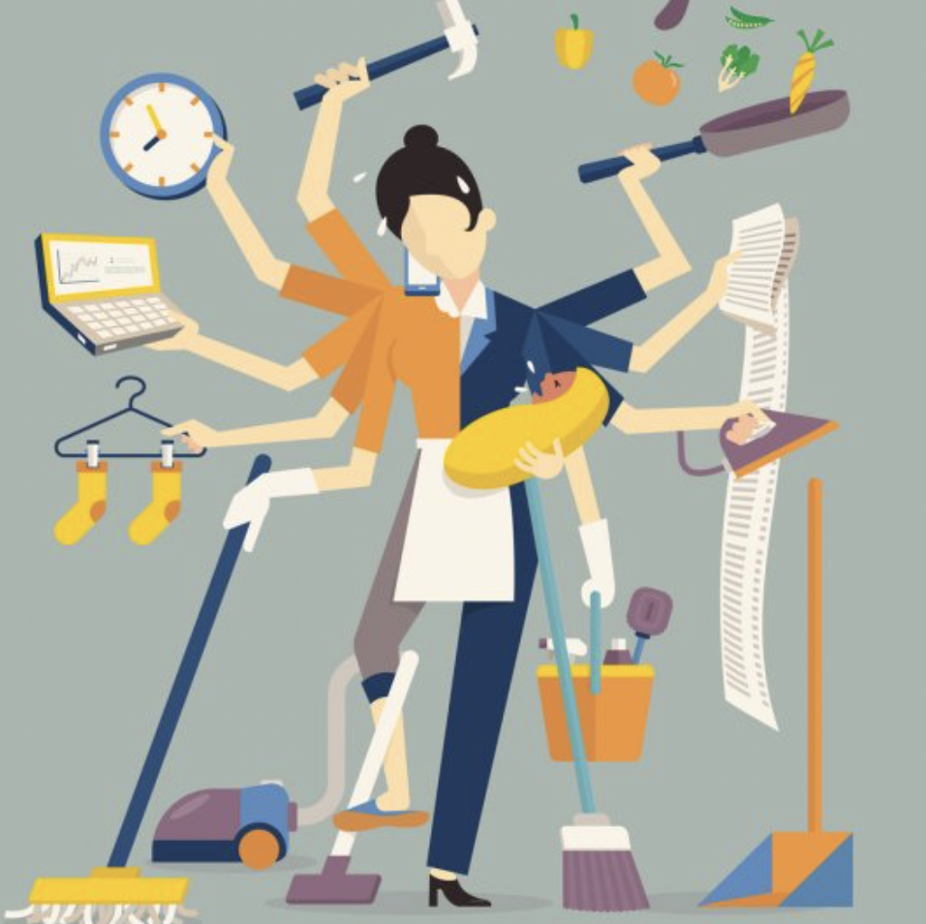
Importance of Parent Wellbeing
Cannot pour from an empty cup
Wear many hats and have many roles; parent, friend, sibling, partner, and carer for ageing parents. ( have not even mentioned work demands yet)
Increased demands with limited resources during Covid - 19.

Slide 14
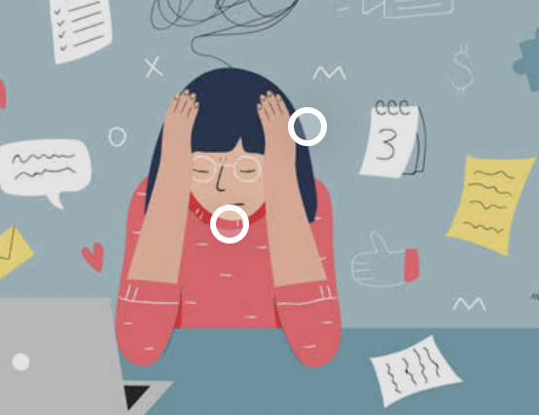
Uncertainty and Stress
We are wired for predictability and certainty.
We can feel destabilised, out - of -sync, lethargic.
Increased stress when uncertain and overwhelmed
Notice changes in mood

Slide 15
Uncertainty and Stress Responding to Stress
Talk about how you are feeling.
Reflect on previous uncertainties - what helped you to get through?
Noticing thoughts and letting go of what is out of your control - can model this to your children to ease their mind.
Mindfulness and Prayer - bringing your mind to the present *Stress is individual - notice what is helpful for you.

Slide 16
Keeping productive (balanced)
Feedback from Wellbeing survey - productivity
Possibly already spread out very thin. Balancing the day - daily planner for yourself (and kids) - set boundaries for self i.e. limit news intake to a specified amount per day
Where possible, do the things that you enjoy, are meaningful, and make you laugh.
Keep note of the positive things

Slide 17
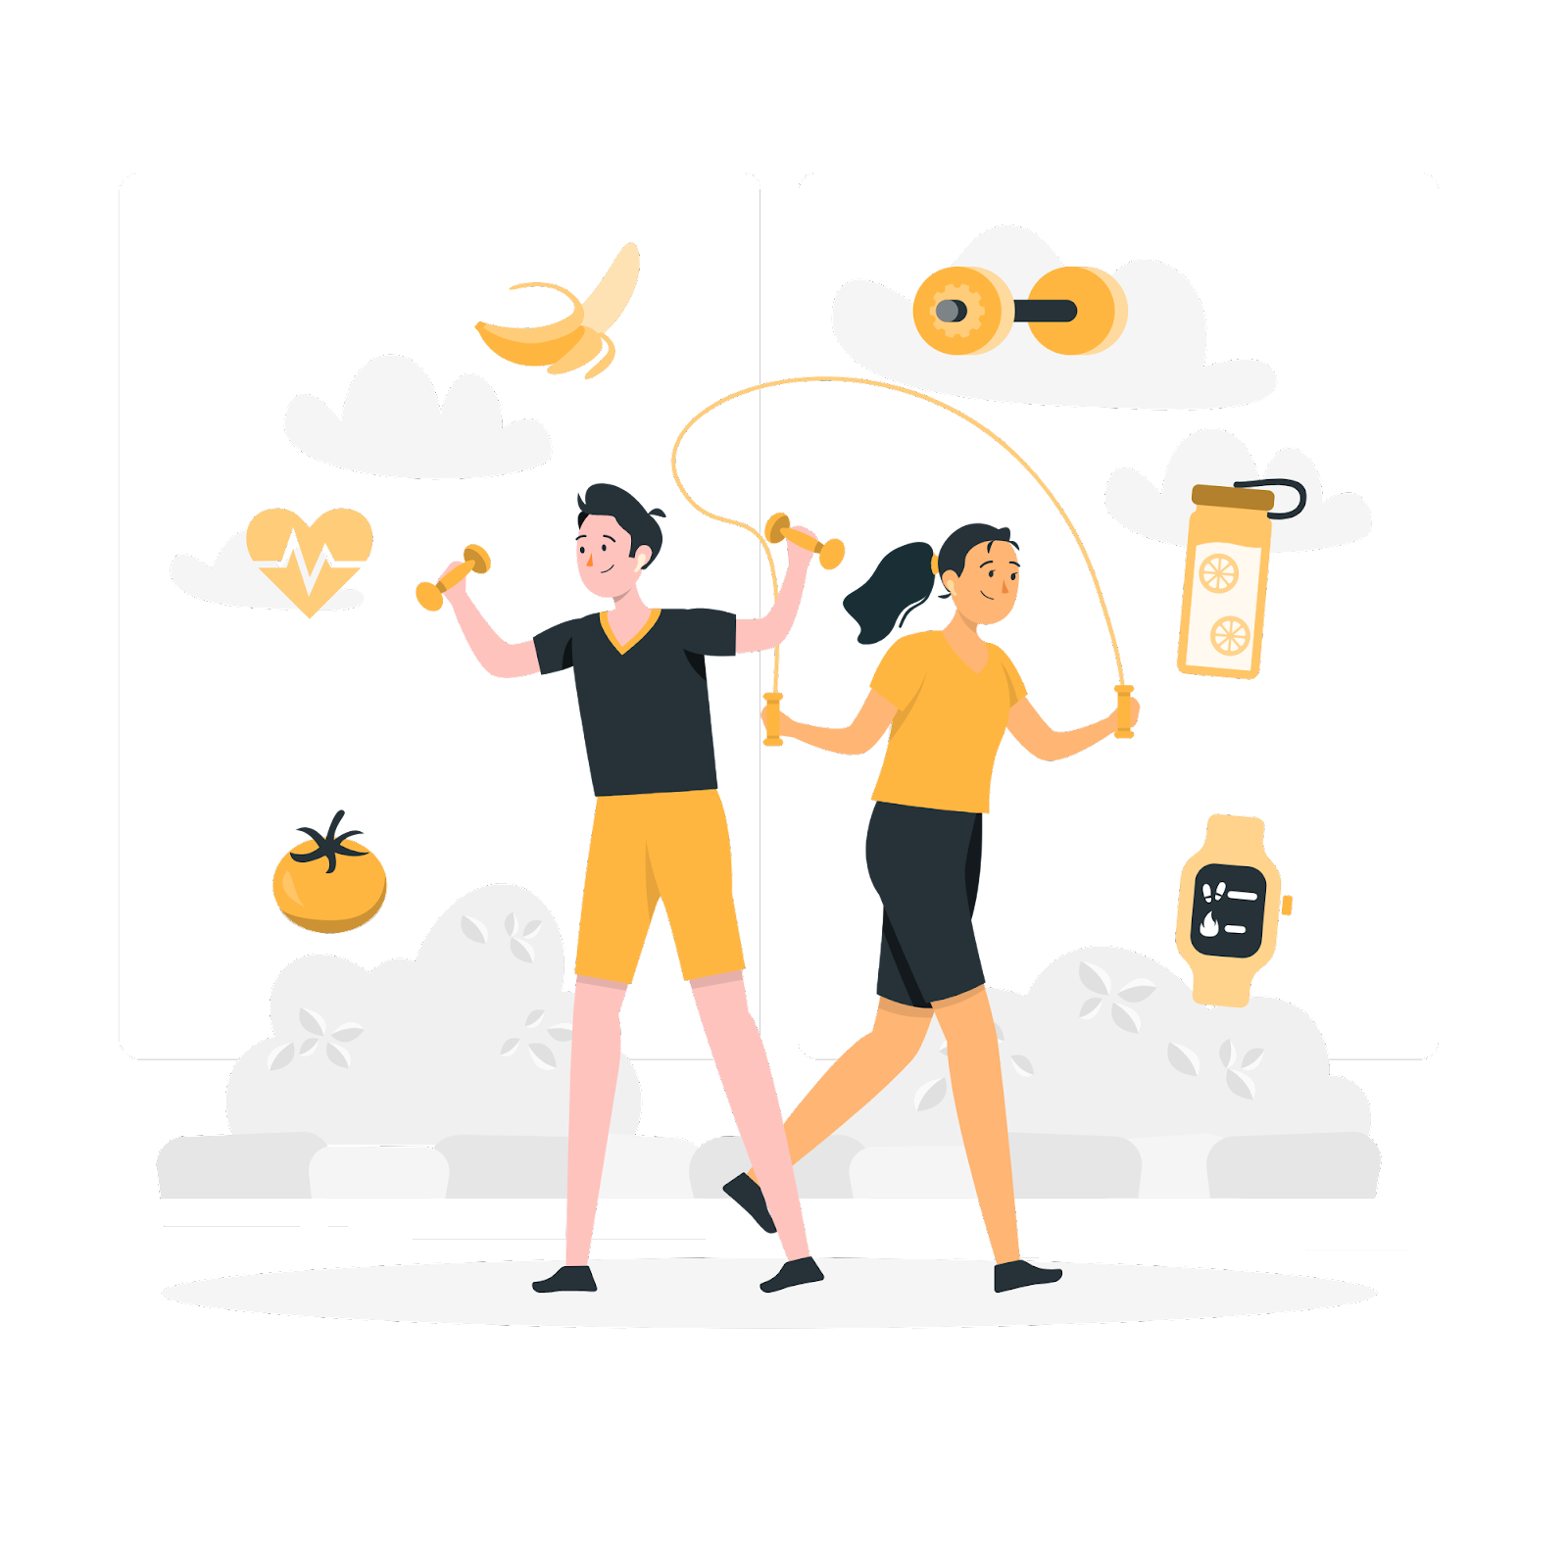
General Wellbeing
The advice we give to our children goes for us as well
Importance of rest
Exercise - stretch, breathe, and move
Connection - family, friends, prayer
Screen time
Nutrition - connected to mood
Keep to a routine where possible (allows for a sense of predictability)

Slide 18
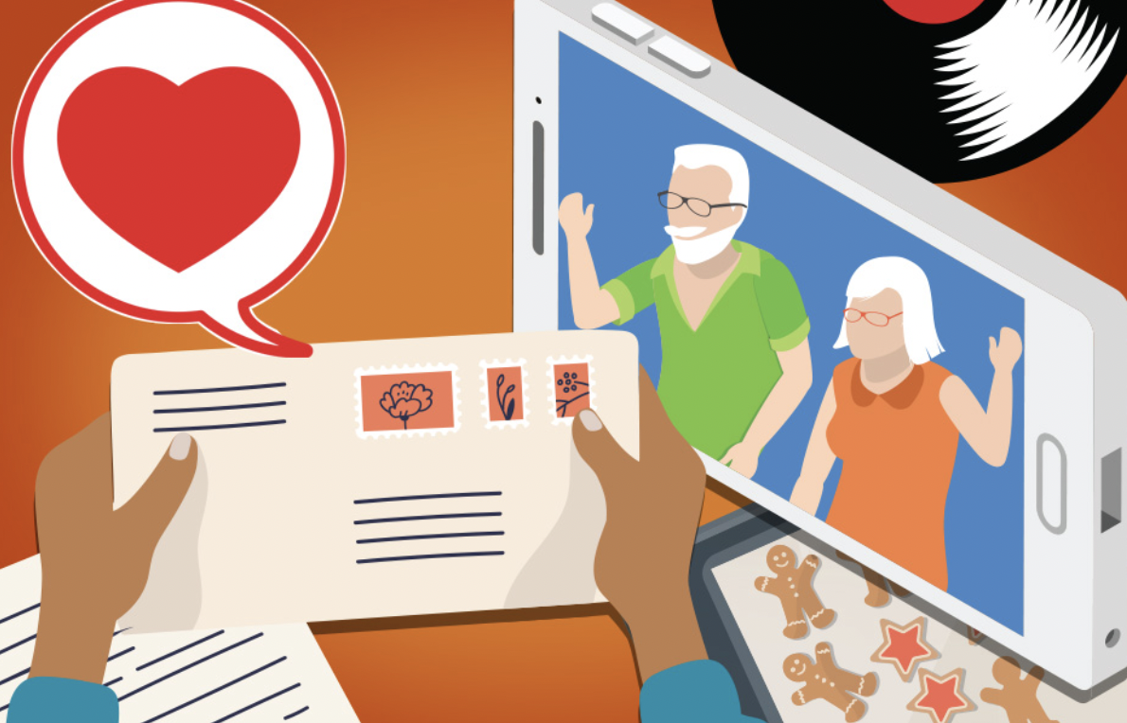
Self Care For Parents
Make time for yourself - walk, read, relax
Connect with loved ones
Nutrition - don’t let your usual health habits slip
Practice self compassion - there is no playbook for this situation and you are doing your very best

Slide 19
Contact Details

Slide 20
Upcoming PBIS Parent workshop! 7th of September 7:00pm to 8:00pm via Zoom

